Slide 1


CSE 470 – SDLC, Waterfall Model
BRAC University

Slide 2
Software Development life Cycle (SDLC)
What components of SDLC we need to learn:
Communication:
Here we do “Requirement collection”. That is knowing what will be in your software
Planning:
Specification(We need to make a concrete documentation what we want to build. What features and functionalities will be there)
Modeling
based on our requirements we do “Requirement Analysis” and “Design” a model
Construction
Then we code, its called “Code generation” and do “Testing”
Once coding is done we need to see how it works. If client wanted a rocket at least we have made an aeroplane which can fly.
Deployment
We need to make it work in real battle field. So we “Release” versions of it and systematically upgrade to reach our goal to make the spaceship. So don’t forget we need proper “Maintenance”

Slide 3
Major Software Production tasks
Requirements analysis:
Analyze software system requirements in detail
Specification:
Develop a detailed specification for the software
Design:
Develop detailed design for the software data structures, software
architecture procedural detail, interfaces
Coding:
Transform design into one or more programming language(s)
Testing:
Test internal operation of the system and externally visible operations & performance
Release:
Package and deliver software to users
Maintenance:
Error correction and enhancement after system

Slide 4
Before solving a problem you always need to:
Understand the problem (communication and analysis).
Plan a solution (modeling and software design).
Carry out the plan (code generation).
Examine the result for accuracy (testing and quality assurance).

Slide 5


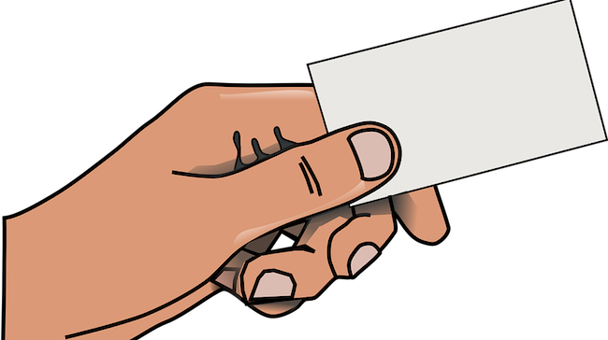
New Project
Team Lead

Slide 6


Model B
Model C
Model A

Slide 7



Small Customer Base
We know What we Want

Slide 8

Waterfall Model
A sequential methodology for software project management.

Slide 9
Requirement Analysis
Design
Coding
Testing
Deployment
Maintenance

Slide 10
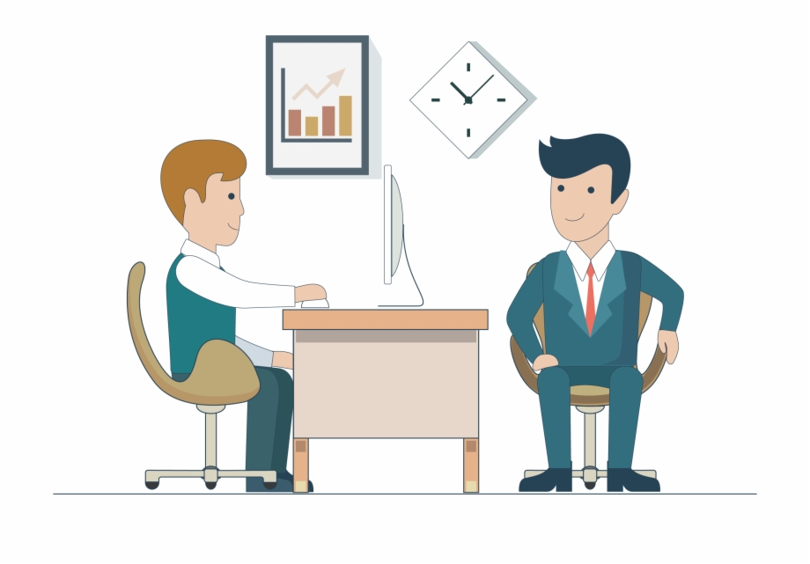

Requirement Collection
It starts with the concept about what the customer wants to do.
Client Meeting
Collect Requirements

Slide 11


Address the problem
Identify the feasible and non-feasible requirements
Identify how the software will meet the customer requirements
APPROVED

Slide 12
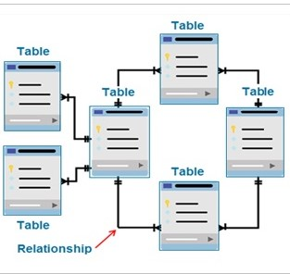
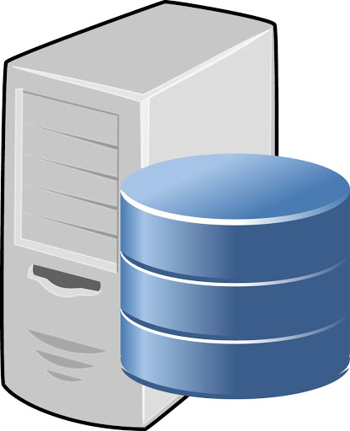
Design
Creates the logical and physical design of the software project
APPROVED

Slide 13
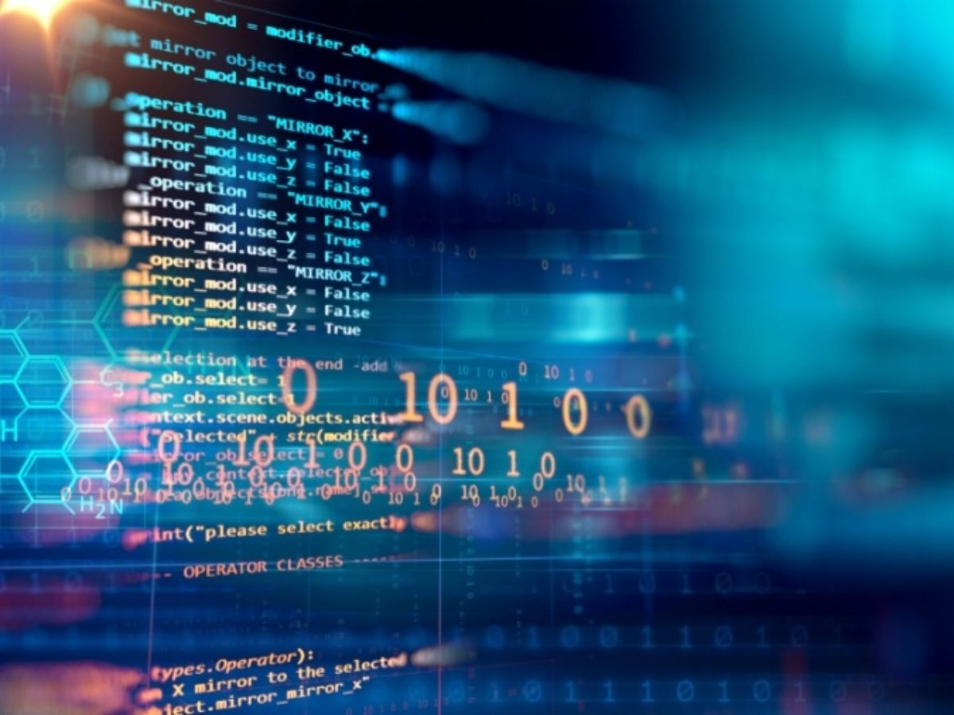
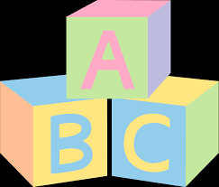
Coding
We need to build it
Coding can not start until design is fixed properly
Starts with converting the design in actual running software.
The design is spilt into blocks, and blocks are converted to code modules on after another.
APPROVED

Slide 14
Testing
Check the software against the requirements set at Requirement Analysis Phase.
In case of any problem, that problem is fixed in the code.
It works perfectly !!
That does not work !!
APPROVED

Slide 15

Deployment and Maintenance
The software is made available in actual information technology environment, specially goes to user environment.
Step by step deployment and maintenance performed
If anything goes wrong here, it will be maintained and resolved by the team.
Feedback may also be collected
Location A
Location B
Location C
Location D

Slide 16
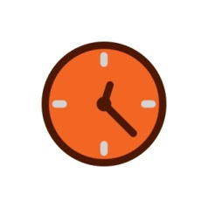

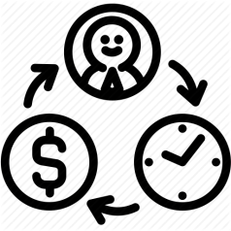

When to choose Waterfall Model
Requirements are well known
Small scale and short term project
Resources are available and trained
Technological tools required are not dynamic, instead are stable

Slide 17

Advantages & Disadvantages
Simple to Use and Easy
Stages go one by one, so there is no sudden change to create confusions
Project is completely dependent on project team with minimum client intervention
Not suitable for complex projects, where requirements change frequently
Testing period comes quite late in the developmental process
Once in testing phase, no more features can be added
Clients valuable feedback cannot be included during the development phase

Slide 18

Example Case
One of your uncle requested you to develop an accounting calculator for his local shop.
Your start-up company wants to develop an accounting calculator for super shops.
Will you use Waterfall model for both Case 1 and 2 ?

